Slide 1


Slide 2


Project Title
Pre-Final Year Project Progress
Submitted by
ROLL NO | NAME
2501060043 | Raghav Gupta
2501060061 | Prakriti Yadav
2501060066 | Dev Sehgal
2501060071 | Kanishk Grover
2501060152 | Aarohi Kalsi
Faculty Mentor: Mr. Digvijay Singh
Notes:
New Courses replaced with New Programmes

Slide 3

Project Overview
In the field of computer applications, data analysis plays an important role in extracting meaningful information from large datasets. Biological health datasets contain structured data related to diseases and population health, that can be effectively analyzed using computational tools.
This project aims to apply basic computing and data analysis techniques to biological health datasets in order to identify disease-related patterns. The focus of the study is on handling, processing, and analyzing health data using programming and statistical methods.
The project handles secondary biological health data and employs data cleaning, organization, visualization, and interpretation through computational approaches.
Notes:
New Courses replaced with New Programmes

Slide 4
Specific Objectives
To apply programming and data analysis concepts to real-world biological datasets
To collect and manage biological health data using computational tools
To perform exploratory data analysis using statistical and visualization techniques
To identify disease-related patterns through data interpretation
To improve practical understanding of data handling and analysis using programming
Notes:
New Courses replaced with New Programmes

Slide 5
Key Features
The project focuses on applying computational techniques to analyze biological health datasets through structured exploratory data analysis. It includes data preprocessing methods such as cleaning, normalization, and handling missing values to ensure reliable analysis.
Statistical summaries and visualizations are generated to reveal disease-related trends and patterns. The system emphasizes data organization, aggregation, and interpretation using programming libraries. The project also promotes reproducibility and documentation of analytical workflows, allowing systematic evaluation of biological health information.
Notes:
New Courses replaced with New Programmes

Slide 6
Progress Summary
An appropriate Health dataset was chosen from valid government provided datasets from ndap.niti.gov.in.
The Health dataset featured various relevant columns – Country, State, Year, Sex, Type Of Disease, Cases and Deaths.
The dataset was imported from the website into a Pandas program for cleaning.
The dataset was cleaned and saved for further analysis.
Notes:
New Courses replaced with New Programmes

Slide 7
Detailed Progress – Development Phase
We decided upon a healthcare related dataset because of its various factors and complex nature.
The dataset was sourced from the National Data and Analytics Platform (NDAP).
The dataset features columns for Country, State, Year, Sex, Type Of Disease, Cases and Deaths.
The dataset was cleaned using a Pandas and numpy program.
- Column names were simplified
- Missing values were filled using mean techniques
Notes:
New Courses replaced with New Programmes

Slide 8
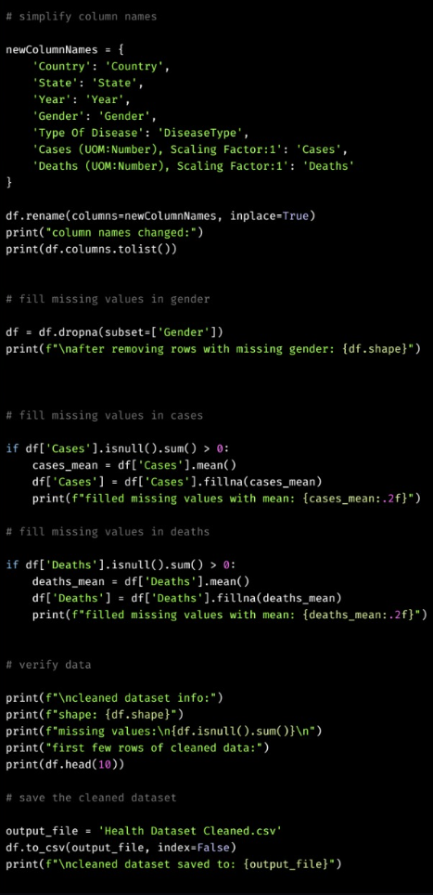
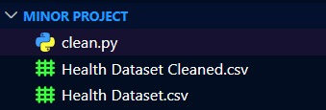
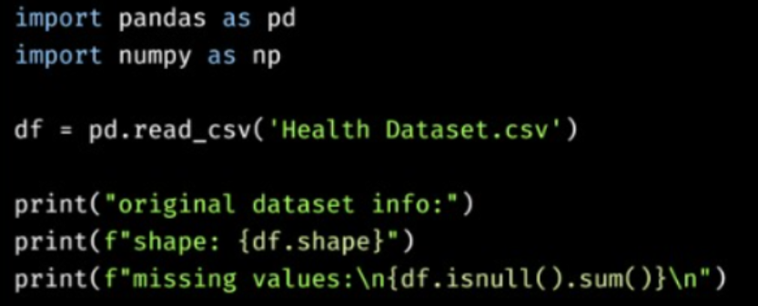
Methodology
Dataset was imported to VS-Code.
Raw data was displayed.
Column Names were simplified and missing values were filled in using mean
Notes:
New Courses replaced with New Programmes

Slide 9

Prototype/Project Flow diagram/Architecture
Dataset is chosen
Dataset is cleaned
Dataset is analyzed
Exploratory data analysis
Conclusions are drawn regarding Dataset
The dataset is visualized
Notes:
New Courses replaced with New Programmes

Slide 10
Project Timeline
Problem statement was chosen.
Problem statement was approved.
Synopsis Presentation was created.
Synopsis Report was finalized.
Dataset was chosen.
Dataset was cleaned.
Midsem Presentation was created.
Notes:
New Courses replaced with New Programmes

Slide 11
Next Steps and Goals
Dataset will be analyzed.
Dataset will be visualized using matplotlib and streamlit.
Conclusions regarding the dataset will be drawn.
Final report will be made.
Notes:
New Courses replaced with New Programmes

Slide 12
Data & Resources
https://ndap.niti.gov.in
https://pandas.pydata.org/docs/
https://numpy.org/doc/
https://projexa.ai/student/e-resources
Notes:
New Courses replaced with New Programmes

Slide 13
Project Usecases & Scope
The scope of this project is limited to exploratory analysis of publicly available biological health datasets using computing tools. It covers data acquisition, preprocessing, statistical exploration, and visualization to identify meaningful disease-related insights.
The project does not attempt predictive modeling or clinical decision-making. Instead, it concentrates on demonstrating how computational methods can be applied to structured health datasets to enhance understanding of biological trends and patterns. The scope ensures practical implementation within academic constraints while maintaining analytical rigor.
Notes:
New Courses replaced with New Programmes

Slide 14
Expected Results & Impact
The project is expected to produce meaningful statistical summaries and visual insights that highlight patterns within biological health datasets. These findings will demonstrate how computational techniques can simplify data interpretation and reveal disease-related trends.
The expected outcome is improved understanding of data handling, visualization, and analytical reasoning using programming tools. The results will showcase the practical role of computing in biological data exploration.
Notes:
New Courses replaced with New Programmes

Slide 15
THANK YOU

